Slide 1
Lecture 8: Implementation
based on Chapter 9

Slide 2
Objectives
Describe
  Characteristics of good implementations
  Best practices to achieve them
Understand role of comments
Learn debugging techniques
Analyze refactoring

Slide 3
Introduction
Implementation: transforming detailed design into valid program
Note that, in some cases (software processes), detailed design may be done as part of implementation
  Faster, but resulting in a less cohesive and less organized design.
Writing code, unit testing, debugging, configuration management

Slide 4
Good implementations
Readability
Maintainability
Performance
Traceability
Correctness
Completeness
Other issues:
  Relative importance ?
  Tradeoffs ?

Slide 5
Coding guidelines
Organization-specific
Important for consistency
Programmers can get used to them easily
Usually mandate:
  Indenting, formatting
  Naming conventions (for files, variables etc)
  Language features to use or avoid

Slide 6
Style issues - I
Be consistent and highlight meaning
Naming
  Convey meaning
  Be consistent
  Warning: If you can’t think of a good name chances are you don’t understand or the design can be improved
  Multicultural issues

Slide 7
Style issues - II
Separating words, capitalization
  c_uses_this_style
  JavaUsesThisOne
Indentation and Spacing
Function/Method size
  When is it too big ? When to break ?
File naming
Error prone constructs

Slide 8
Comments
Types:
  Repeat of the code
  Explanation of the code
  Marker in the code
  Summary of the code
  Description of the code intent
  External references
Keep up to date !!

Slide 9
Coding in detail

Slide 10
Coding in detail
Goal is to implement the design in best possible manner
Coding affects testing and maintenance
As testing and maintenance costs are high, aim of coding activity should be to write code that reduces them
Hence, goal should not be to reduce coding cost, but testing and maintenance cost, i.e. make the job of tester and maintainer easier
Coding

Slide 11
Coding…
Code is read a lot more
  Coders themselves read the code many times for debugging, extending etc
  Maintainers spend a lot of effort reading and understanding code
  Other developers read code when they add to existing code
Hence, code should be written so it is easy to understand and read, not easy to write!
Coding

Slide 12
Coding…
Having clear goal for coding will help achieve them
Weinberg experiment showed that coders achieve the goal they set
  Different coders were given the same problem
  But different objectives were given to different programmers – minimize effort, minimize size, minimize memory, maximize clarity, maximize output clarity
  Final programs for different programmers generally satisfied the criteria given to them
Coding

Slide 13
Common Coding Errors
Memory Leaks
  Memory that is not freed when no longer needed
Freeing an already freed resource
NULL dereferencing
  Trying to access the contents of a location that points to NULL
Lack of unique addresses
  Caused by aliasing
Array index out of bound
Arithmetic exceptions
Off by one
  Starting at 1 when we should start at 0
Enumerated data types
  Cause overflow and underflow
Illegal use of & instead of &&
String handling errors
Buffer overflow
Coding

Slide 14
Programming Principles
Structured programming
Information hiding
Programming practices
Coding standards
Coding

Slide 15
Structured Programming
Structured programming started in the 70s, primarily against indiscriminate use of control constructs like gotos
Goal was to simplify program structure so it is easier to understand programs
Is now well established and followed
Coding

Slide 16
Structured Programming…
A program has a static structure which is the ordering of statements in the code – and this is a linear ordering
A program also has dynamic structure –order in which statements are executed
Both dynamic and static structures are ordering of statements
Correctness of a program must talk about the dynamic structure
Coding

Slide 17
Structured Programming…
To show a program as correct, we must show that its dynamic behavior is as expected
But we must argue about this from the code of the program, i.e. the static structure
  I.e. program behavior arguments are made on the static code
This will become easier if the dynamic and static structures are similar
This is the idea behind structured programming
Coding

Slide 18
Structured Programming…
Goal of structured programming is to write programs whose dynamic structure is same as static
I.e. statements are executed in the same order in which they are present in code
As statements organized linearly, the objective is to develop programs whose control flow is linear
Coding

Slide 19
Structured Programming… single-entry-single-exit
Meaningful programs cannot be written as sequence of simple statements
To achieve the objectives, structured constructs are to be used
These are single-entry-single-exit constructs
With these, execution of the statements can be in the order they appear in code
The dynamic and static order becomes same
Coding

Slide 20
Structured Programming… clear behavior
Each structured construct should also have a clear behavior
Then we can compose behavior of statements to understand behavior of programs
Hence, arbitrary single-entry-single-exit constructs will not help
  Need more than sequence of statements
  Need control structures
It can be shown that a few constructs like while, if, and sequencing suffice for writing any type of program
Coding

Slide 21
Structured Programming… formal verification
Structured Programming was promulgated to help formal verification of programs
Without linear flow, composition is hard and verification difficult
But, Structured Programming also helps simplify the control flow of programs, making them easier to understand
Structured Programming is an accepted and standard practice today – modern languages support it well
Coding

Slide 22
Information Hiding
Software solutions always contain data structures that hold information
Programs work on these data structures to perform the functions they want
In general only some operations are performed on the information, i.e. the data is manipulated in a few ways only
E.g. on a bank’s ledger, only debit, credit, check current balance etc. are done
Coding

Slide 23
Information Hiding… only expose operations on data
Information hiding – the information should be hidden; only operations on it should be exposed
I.e. data structures are hidden behind the access functions, which can be used by programs
Information hiding reduces coupling
This practice is a key foundation of OO and components, and is also widely used today
Coding

Slide 24
Some Programming Practices
Control constructs: Use only a few structured constructs (rather than using a large number of constructs)
Goto: Use them sparingly, and only when the alternatives are worse
Information hiding: Use information hiding
Use-defined types: use these to make the programs easier to read
Coding

Slide 25
Some Programming Practices..
Nesting: Avoid heavy nesting of if-then-else
  Easier to do if conditions are disjoint
Module size: Should not be too large – generally means low cohesion
Module interface: make it simple
Robustness: Handle exceptional situations
Side effects: Avoid them, document when exist
  Use of global variables, etc.
Switch case with default
Coding

Slide 26
Some Programming Practices..
Empty catch block: always have some default action rather than empty
Empty if, while: bad practice
Read return: should be checked for robustness
Return from finally: should not return from finally
Correlated parameters: Should check for compatibility
  Parameter needs to match the operation
Coding

Slide 27
Coding Standards
Programmers spend more time reading code than writing code
They read their own code as well as other programmers code
Readability is enhanced if some coding conventions are followed by all
Coding standards provide these guidelines for programmers
Generally are regarding naming, file organization, statements/declarations, …
Some Java conventions discussed here
Coding

Slide 28
Coding Standards…
Naming conventions
  Package name should be in lower case
    mypackage, edu.iitk.maths
  Type names should be nouns and start with uppercase
    Day, DateOfBirth, EventHandler
  Variable names should be nouns in lowercase
    name, amount
  Variables with large scope should have long names; variables with small scope short names
  Loop iterators should be i, j, k…
  Constant names should be all uppercase
    PI, MAX_INTERACTIONS
  Method names should be verbs starting with lower case
    getValue()
Coding

Slide 29
Coding Standards…
Naming conventions…
  Private class variables should have the _ suffix
    private int value_
  Prefix is should be used for Boolean methods
    isStatus,
  Avoid negative Boolean variable names
    isNotCorrect
  Use term compute for methods that computes something
    computeMean()
  Use term find for methods that looks up something
    findMin()
  Exception classes should be suffixed with Exception
    OutOfBoundException
Coding

Slide 30
Coding Standards…
Files
  Source files should have .java extension
  Each file should contain one outer class and the name should be same as file
  Line length should be less than 80
    If longer continue on another line
  Special characters should be avoided
Coding

Slide 31
Coding Standards…
Statements
  Variables should be initialized where declared in the smallest possible scope
  Declare related variables together; unrelated variables should be declared separately
  Class variables should never be declared public
  Loop variables should be initialized just before the loop
  Avoid using break and continue in loops
  Avoid executable statements in conditionals
  Avoid using the do… while construct
  Avoid complex conditional expressions
    Introduce temporary Boolean variables instead
  Avoid executable statements in conditionals
Coding

Slide 32
Coding Standards…
Commenting and layout
  Single line comments for a block should be aligned with the code block
  There should be comments for all major variables explaining what they represent
  A comment block should start with a line with just /* and end with a line with */
  Trailing comments after statements should be short and on the same line and shifted far enough to separate them from statements
Coding

Slide 33
Coding Process
Coding starts when specifications for modules from design is available
Usually modules are assigned to programmers for coding
In top-down development, top level modules are developed first; in bottom-up lower level modules
For coding, developers use different processes; we discuss some here
Coding

Slide 34
An Incremental Coding Process
Basic process: Write code for the module, unit test it, fix the bugs
It is better to do this incrementally – write code for part of functionality, then test it and fix it, then proceed
I.e. code is built for a module incrementally
Coding

Slide 35
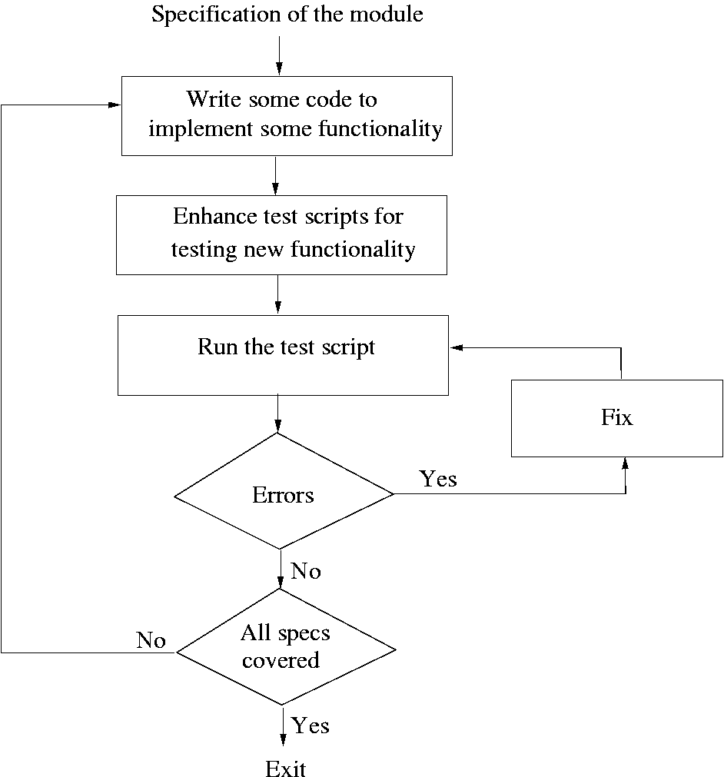
Coding

Slide 36
Debugging
Locating and fixing errors in code.
Errors noticed by testing, inspection, use.
Four phases
  Stabilization (reproduction)
  Localization
  Correction
  Verification

Slide 37
Debugging II
Heuristics:
  Some routines will have many errors
  Routines with an error tend to have more
  New code tends to have more error
  Particular ones: languages, parts, coders
Tools
  Code comparators
  Extended checkers (lint)
  Interactive debuggers
  Special libraries
  Others: Profilers, pre/post conditions, test coverage

Slide 38
Assertions
Pre-condition: condition your module requires in order to work
Post-condition: condition that should be true if your module worked
Assertion: Executable statement that checks a condition and produces an error if it is not met
Assertions supported by many languages

Slide 39
Performance optimization
Performance tradeoffs
  Readability ?
  Maintainability ?
Correctness is usually more important
Profiler: runs a program and calculates how much time it spends on each part
Cost-benefit analysis
Measure before ‘optimizing’

Slide 40
Refactoring
Def: Improving your code style without affecting its behavior
Examples of “Bad Smells” codes
Duplicated code
Long method
Large class
Switch statement
Feature envy
Intimacy
Refactoring methods:
Extract method
Substitute algorithm
Move method
Extract class: dividing a class into two

Slide 41
Summary
Goal of coding is to convert a design into easy to read code with few bugs
Good programming practices like structured programming, information hiding, etc can help
There are many methods to verify the code of a module – unit testing and inspections are most commonly used
Size and complexity measures are defined and often used; common ones are LOC and cyclomatic complexity
Coding

